Slide 1


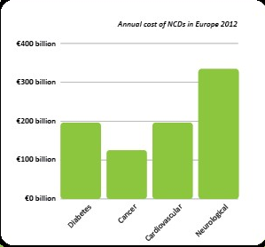
IEHG’s Quality & Patient Safety (QPS) team are delighted to support
National Brain Awareness Week
Please see webinar details and links below.
Date | Speaker | Title | Link
13/3/23 1-2pm | Vanessa Lefort Neurology RGN, NTPF team SVUH | Migraines- Understand them better to manage them better' | Join Zoom Meeting https://us04web.zoom.us/j/79921275158?pwd=EsEfJsvwEzfj7G1Q2qKXUkwL90wMWG.1 Meeting ID: 799 2127 5158 Passcode: TuJ6qc
14/3/23 1-2pm | Brian Magennis ANP MMUH - Care of the Older Person | Parkinson’s Disease Medication - old and new | Join Zoom https://mater-ie.zoom.us/j/82023297319
 | Tibbs Pereira Patients for Patient Safety Ireland | My Medicine List
15/3/23 1-2pm | Roisin Riches ANP MMUH ED Frailty Intervention Team | Delirium | Join Zoom https://mater-ie.zoom.us/j/82023297319
Did You Know?
1 in 3 People
will experience
a neurological condition in their lifetime
#BRAINAWARENESSWEEK2023 #INVESTINBRAINHEALTH
Go to www.loveyourbrain.ie for more details
The cost of neurological disorders in Europe alone is 336 billion euros annually and growing
#BRAINAWARENESSWEEK2023 #INVESTINBRAINHEALTH
Go to www.loveyourbrain.ie for more details
Keep up- to-date with news and events
#BRAINAWARENESSWEEK2023
#INVESTINBRAINHEALTH
Visit www.loveyourbrain.ie for more details including a calendar of events with the Neurological Alliance for Ireland’s partners

